Slide 1
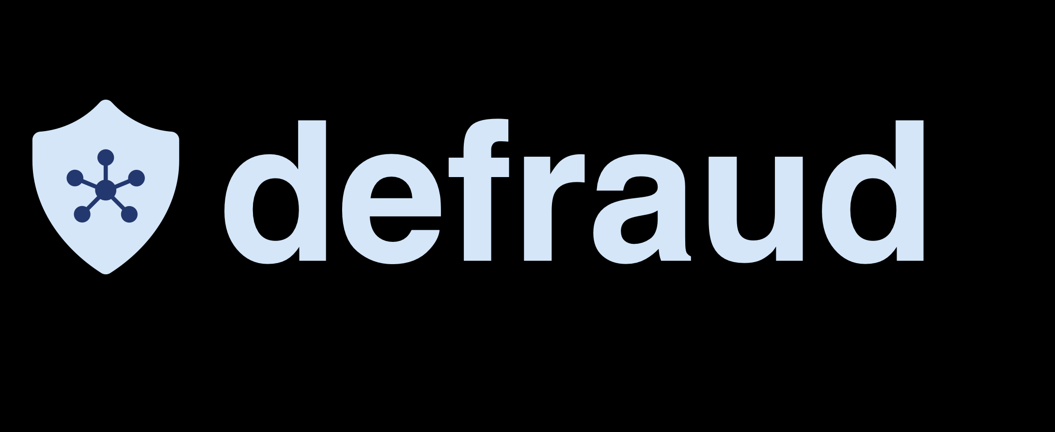
1,561,739
stolen cards
in 2021 only in the US.

Slide 2
4,278
stolen cards
a day only in the US.

Slide 3




Bank's dilemma
must cover the customer's loss
needs to verify the information

Slide 4




Problems
MANY TRANSACTIONS
AT LEAST 5 DOCUMENTS
ACTORS & STEP-BY-STEP PROGRESS
TIME

Slide 5

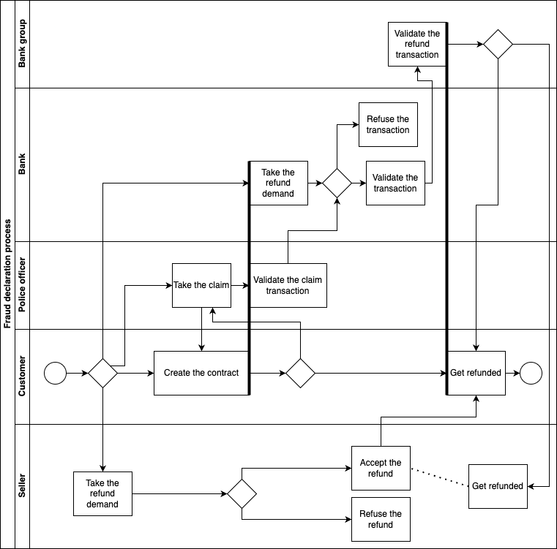

Slide 6



defraud
1st credit card fraud recovery dapp

Slide 7

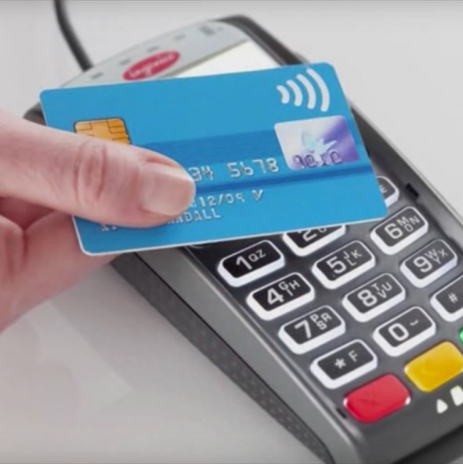


Solutions
ACTORS MANAGEMENT
FUNDS MANAGEMENT
SPEED & SECURITY
DOCUMENTS
5 actors
3 capabilities
stored on the contract
must validate conditions
access highly controlled
from 1 week to 6 months to…
1 day at best

Slide 8

More blockchain…
Interoperability
Decentralized application usable across banks
Desynchronized steps
All actors can fulfil their tasks without waiting for someone else (except for receiving funds)
Fewer falsified declarations

Slide 9



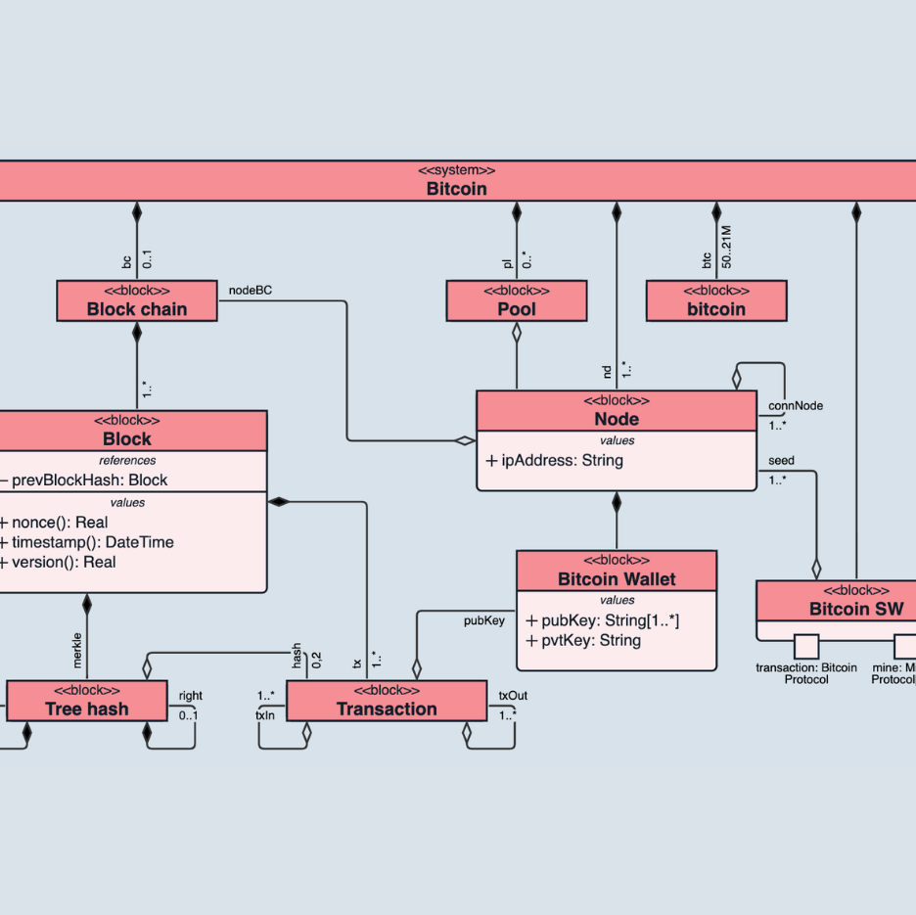
Sui Blockchain & defraud
Security
Sponsored transactions
(not implemented yet)
Objects
& Speed

Slide 10
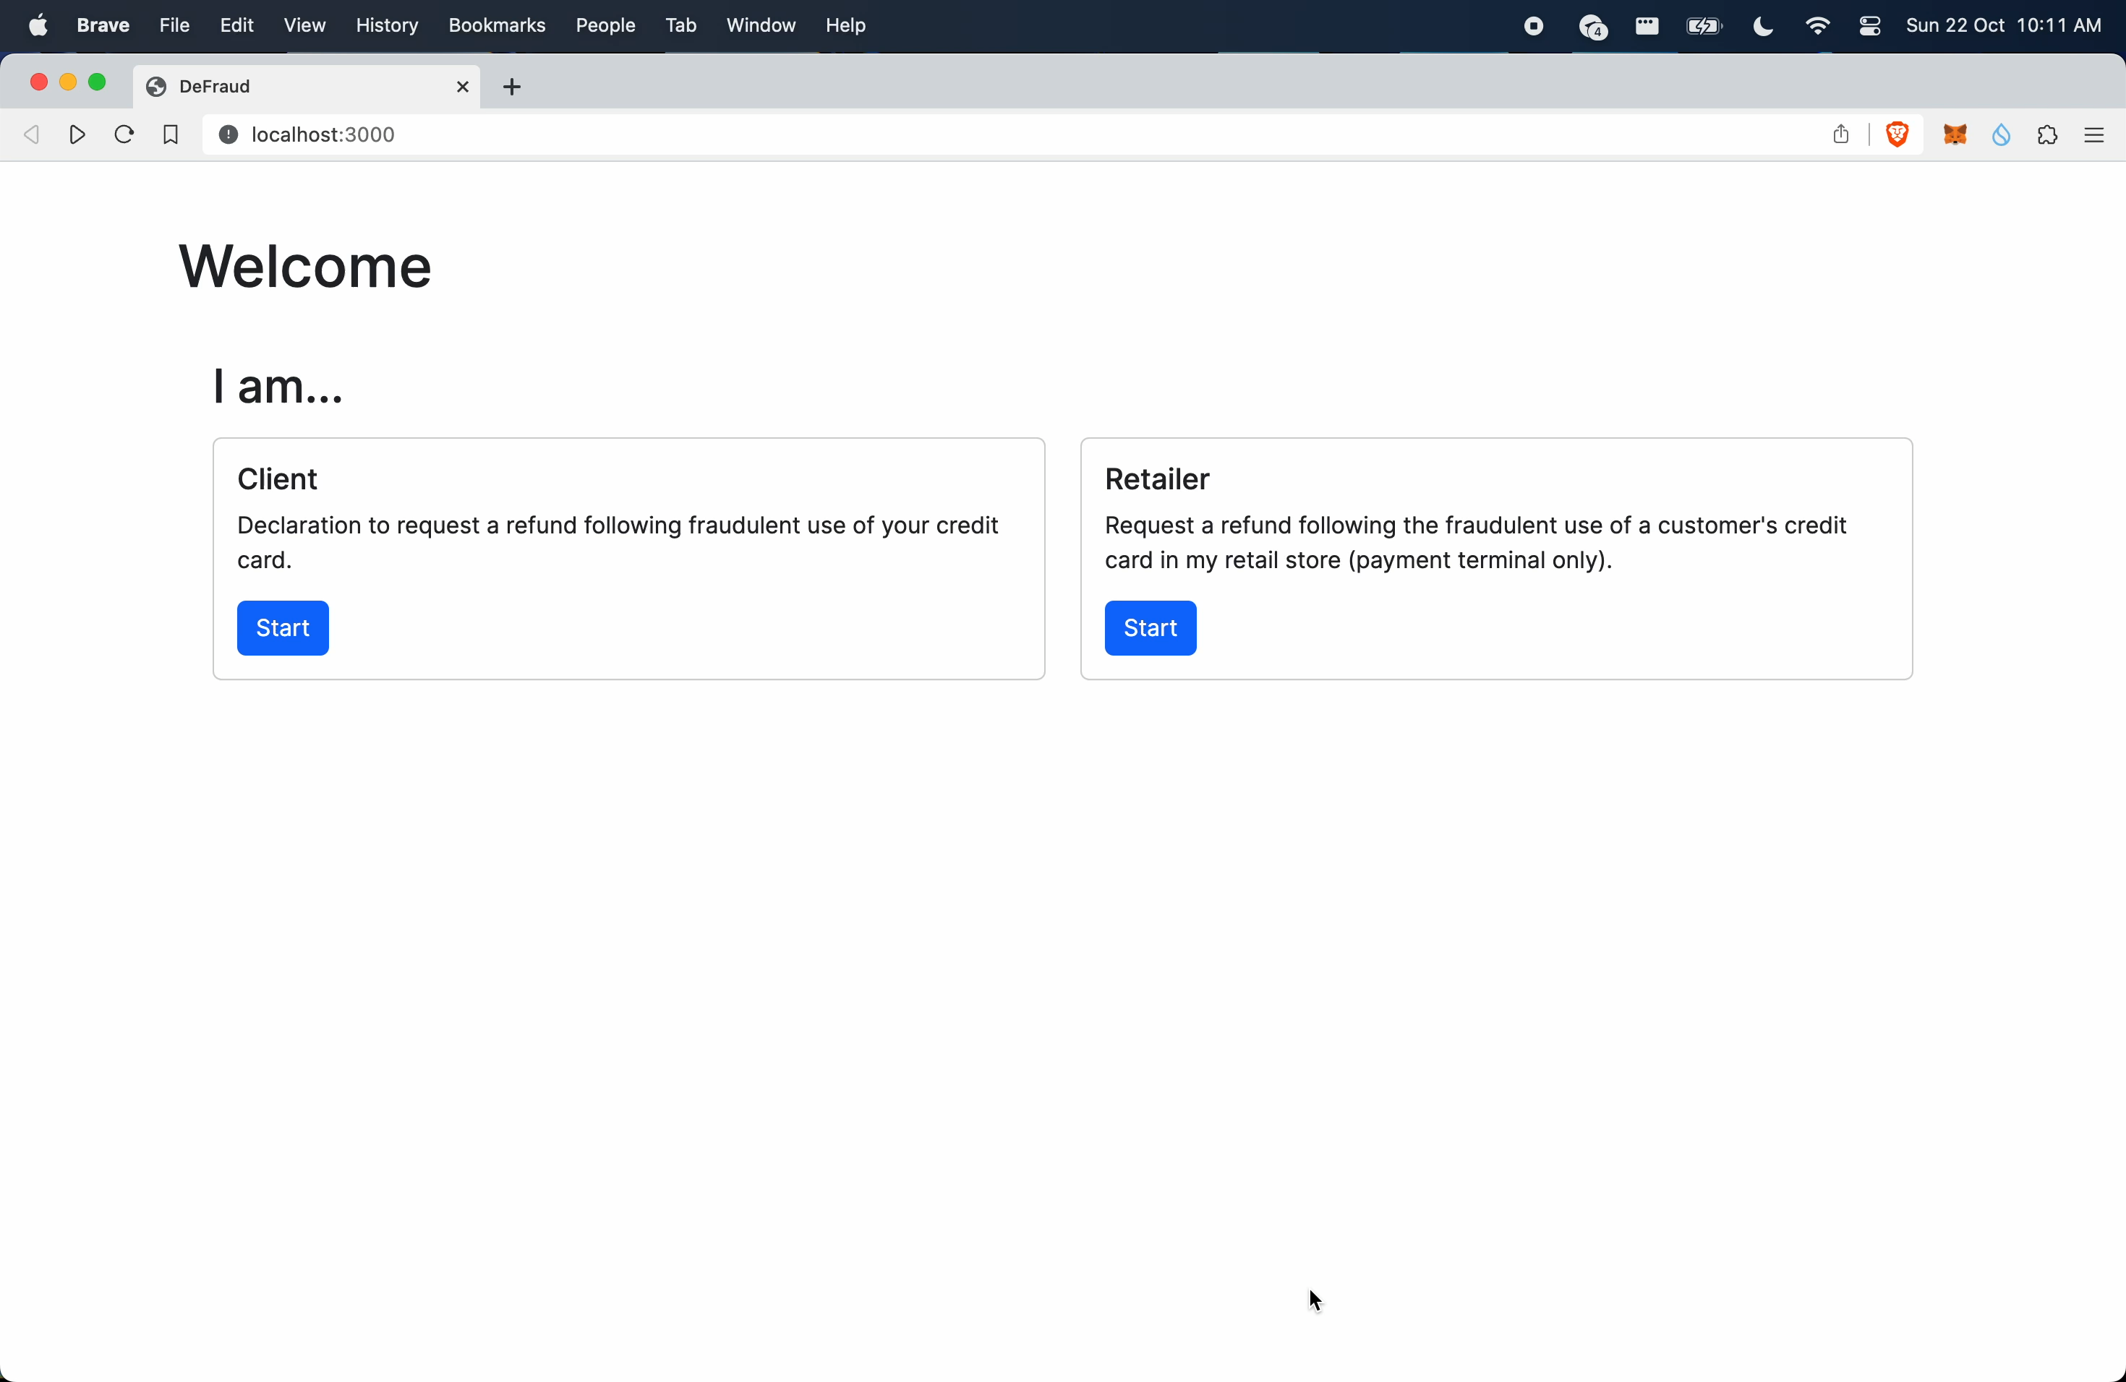

Slide 11
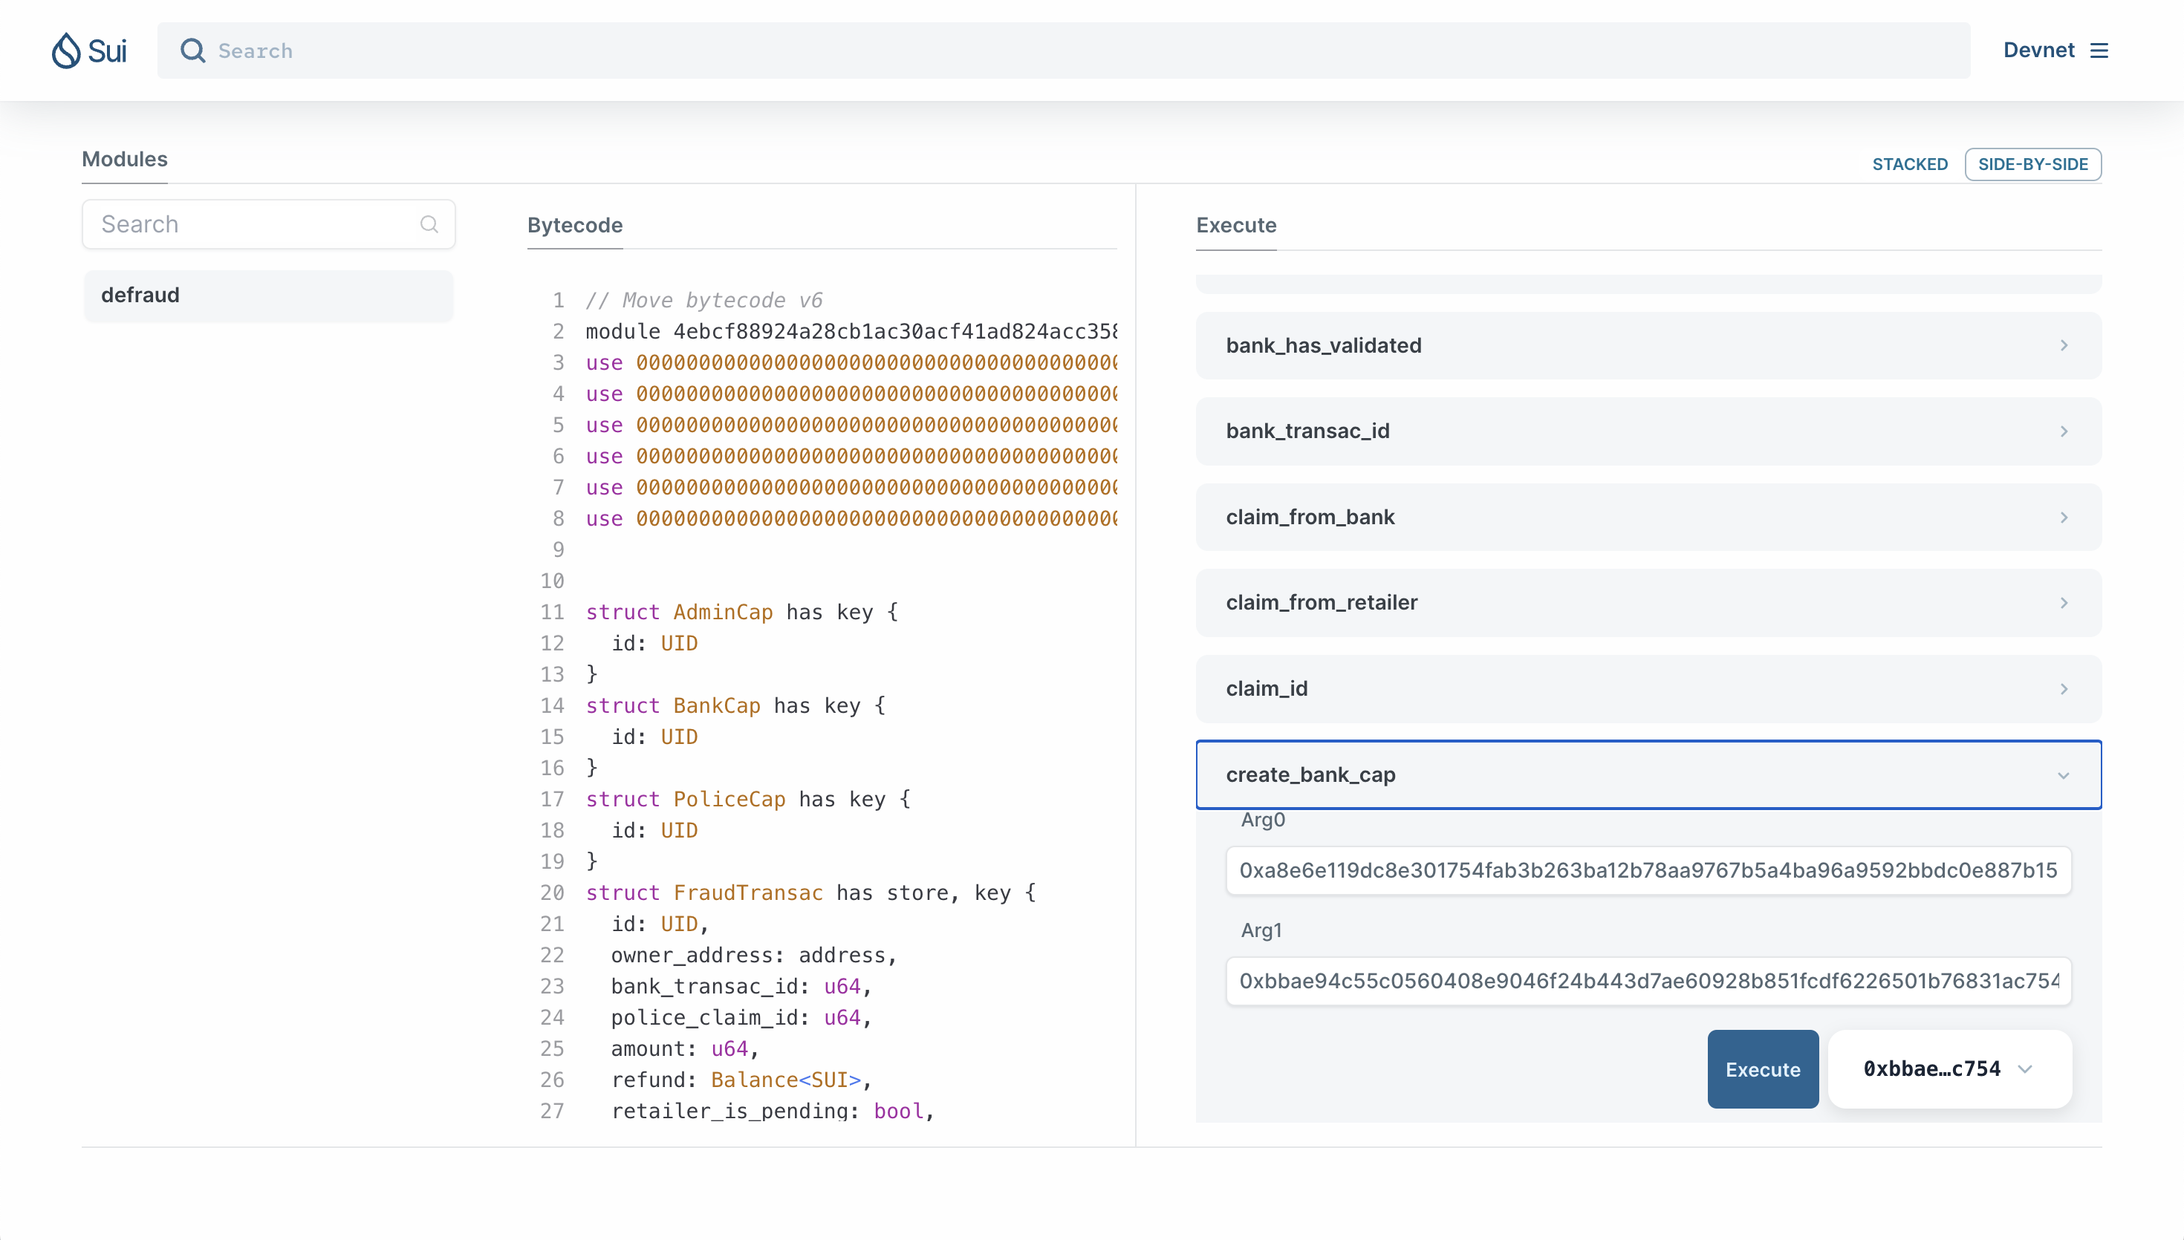

Slide 12
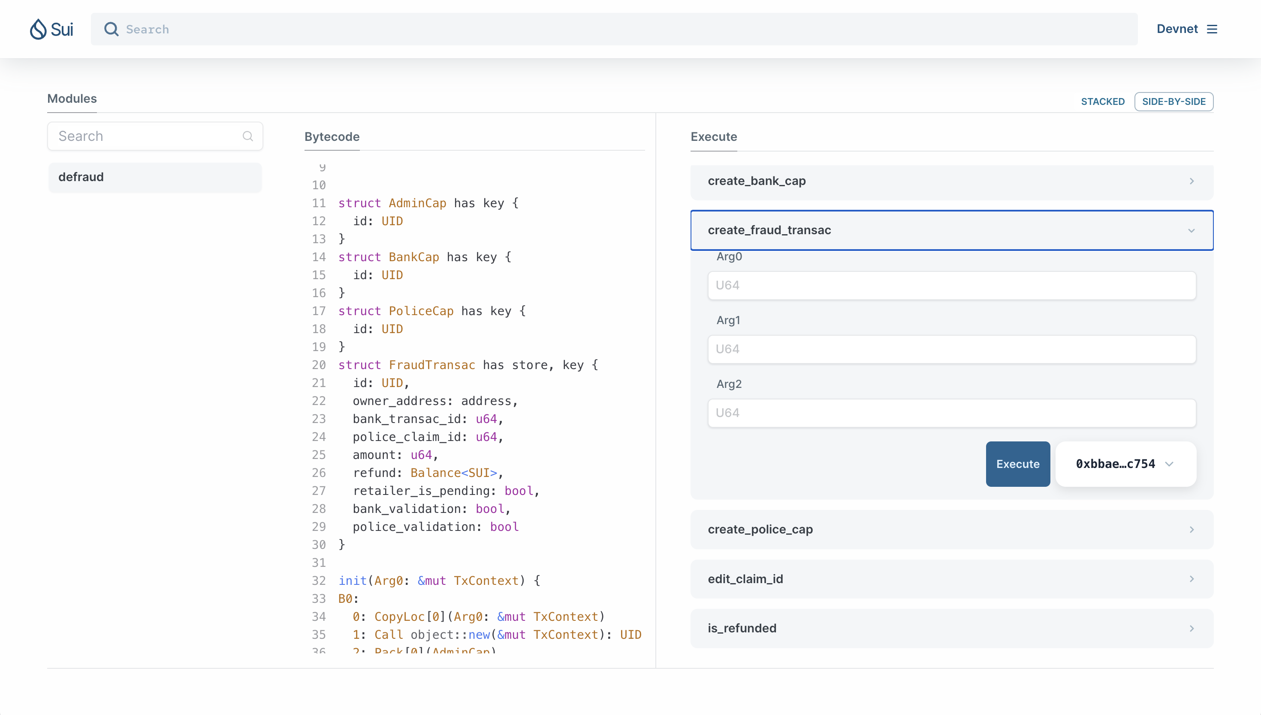

Slide 13




much less time required to process a refund request
simplify the work of a team of twenty people in each district bank
help reduce ecological impact
save money and labour for a bank
save companies an average of 2% on turnover

